Slide 1


Counseling Review
Tri-Service Hearing Technician
4.2 Certification Course

Slide 2
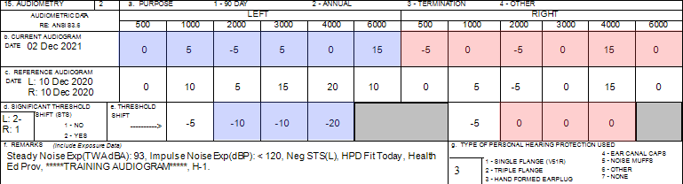
Counseling
Group Counseling Demonstration
[SSN = 990990001] Is there a change in hearing (ear specific)? (page 94)
Are thresholds within the range of normal (ear specific)?
Where does the patient need to go?
Additional Comments?
Notes:
Negative STS - Airman initial annual test after reference was established; results meant to provide an example of a patient who requires individual counseling for follow-up requirements of a negative STS; good policy to review audiometric history; Retest while counseling other patients retest

Slide 3
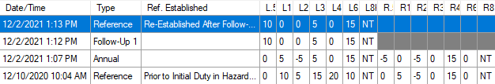
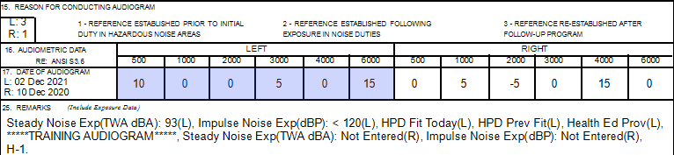
Counseling
Group Counseling Demonstration
[SSN = 990990001] Are thresholds within the range of normal (ear specific)? (page 94)
Where does the patient need to go?
Additional Comments?
Notes:
Negative STS - Airman initial annual test after reference was established; results meant to provide an example of a patient who requires individual counseling for follow-up requirements of a negative STS; good policy to review audiometric history; -STS still present, application auto re-established baseline with Follow-up 1 results. Student can look at data in their own database, viewing the 990990001 DD Form 2216 initial, follow-up test and re-established baseline in the print window to observe/review

Slide 4
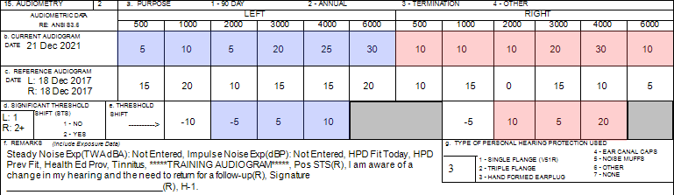
Counseling
Group Counseling Demonstration
[SSN = 990990021] Is there a change in hearing (ear specific)? (page 95)
Are thresholds within the range of normal (ear specific)?
Where does the patient need to go?
Additional Comments?
Notes:
Patient history - enjoys going to the range to fire weapons, left-handed shooter, previously seen by an audiologist for Asymmetry; results meant to provide an example of a patient who requires individual counseling for follow-up requirements of a positive STS; ensure patient signs 2216; What happens when the patient comes back? Their threshold levels at that time?
Student can look at data in their own database, viewing the 990990021 DD Form 2216 in the print window to observe/review

Slide 5
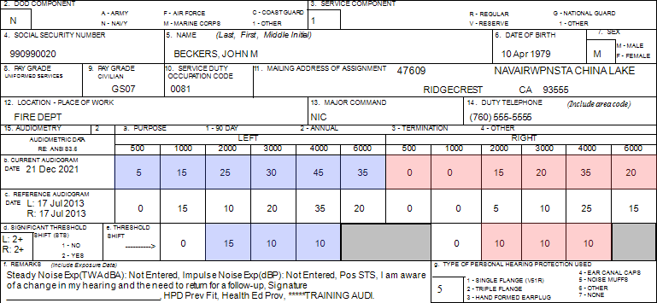
Page 96; Confirm demographic fields 2 thru 14; Is there a change in hearing (ear specific)? Are thresholds within the range of normal (ear specific)? Where does the patient need to go? Additional Comments?
Notes:
Provide normal parameters of hearing; explanation of an STS and other data that may be included in remarks section
Remarks on the 2216 are specific to the latest test on the 2216
Student can look at data in their own database, viewing the 990990020 DD Form 2216 tests in the print window to observe/review
What happens when the patient comes back? Their threshold levels at that time?

Slide 6
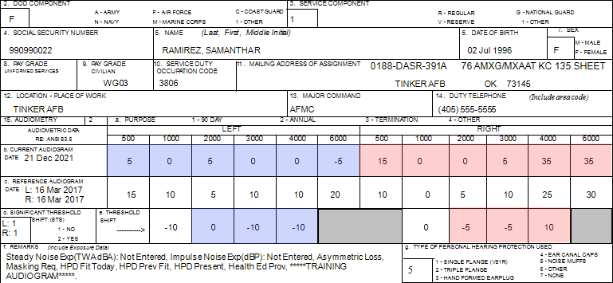
Page 96; Confirm demographic fields 2 thru 14; Is there a change in hearing (ear specific)? Are thresholds within the range of normal (ear specific)? Where does the patient need to go? Additional Comments?
Notes:
Patient history: USAF civilian, Sheet Metal Mechanic
Student can look at data in their own database, viewing the 990990022 DD Form 2216 in the print window to observe/review
Asymmetry, masking requirement

Slide 7
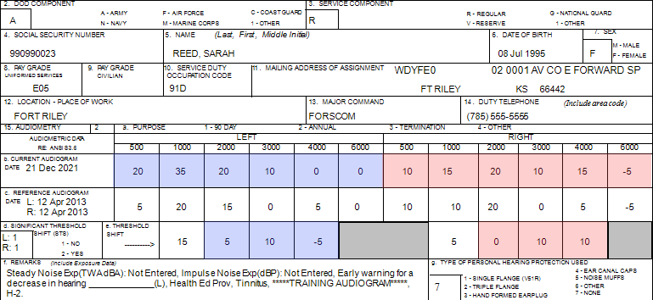
Page 97; Confirm demographic fields 2 thru 14; Is there a change in hearing (ear specific)? Are thresholds within the range of normal (ear specific)? Where does the patient need to go? Additional Comments?
Notes:
USA Patient was previously an H-1, this audiogram they are an H-2, USA uses better ear for profiling; profile change requires referral to audiologist. Possibly has conductive issues, bringing down 1000 Hz Left ear would revert back to a H-1… Also looking at patient history, a tech did a reference type 2 instead of an annual test in 2018. Note: HPDs = none (discuss)
Student can look at data in their own database, viewing the 990990023 DD Form 2216 in the print window to observe/review

Slide 8
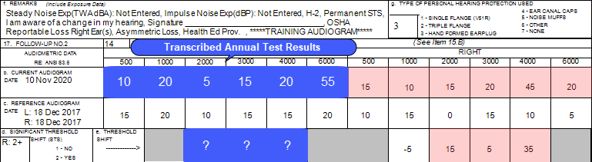
[SSN = 990990021] Confirm demographic fields 2 thru 14 (page 101)
Is there a change in hearing (ear specific)?
Are thresholds within the range of normal (ear specific)?
Where does the patient need to go?
Does the patient meet the 3 conditions for OSHA reportable (Remarks)?
Tri-Service Hearing Technician 4.2.0.0 Certification Course
Notes:
Do a brief review of counseling; have patient confirm their data in demographic fields 2 thru 14.
Is there a change in hearing? Yes
Are thresholds within the range of normal? No, Both ears moderate hearing loss
Where does the patient need to go? Refer to audiologist, Positive STS right ear, Asymmetry
Have students write responses in their training booklet

Slide 9
Counseling Review
? Questions ?
Tri-Service Hearing Technician
4.2 Certification Course

